Slide 1
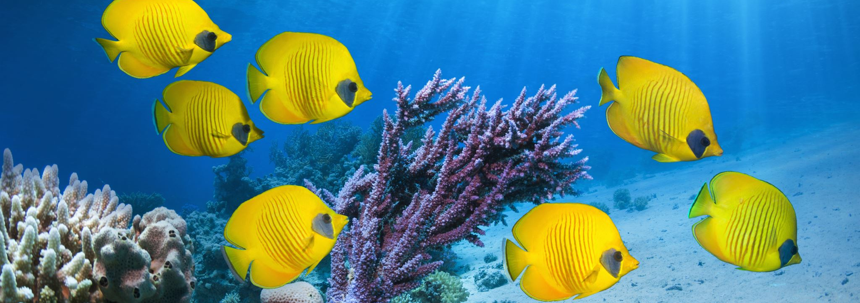
THE EFFECT OF gene deletion in Cassiopea Spp. On bleaching
By Anastasia Ignashkina

Slide 2
Hypothesis
If the gene is knocked out of the jelly fish, Cassiopea spp., it will affect bleaching

Slide 3
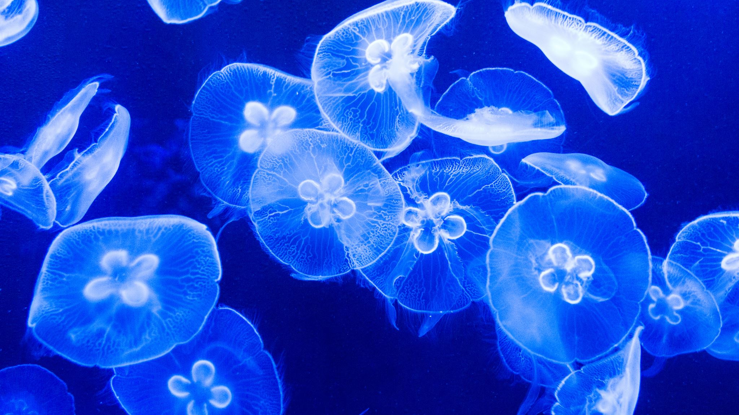
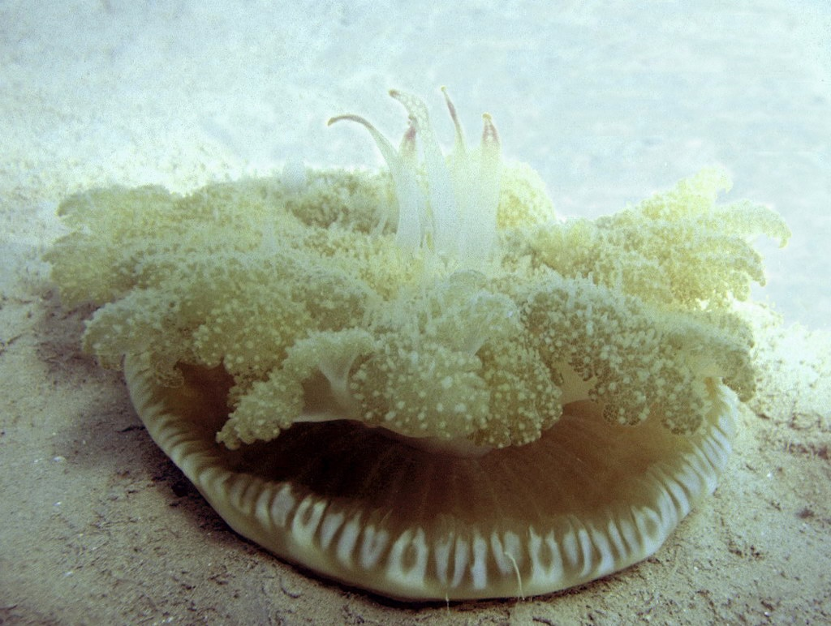
Cassiopea spp.
Species: spp.
Genus: Cassiopea
Family: Cassiopeidae
Order: Rhizostomeae
Class: Scyphozoa
Phylum: Cnidaria
Kingdom: Animalia
Cassiopea Spp. is an upside-down jellyfish occurs naturally across a broad range of tropical locations. Some species are considered invasive, and their large accumulation can adversely affect the local marine environment and affect the use of waterways. However, others, grown in Pennsylvania's labs, can help to protect the fragile coral reefs of the world's oceans.

Slide 4
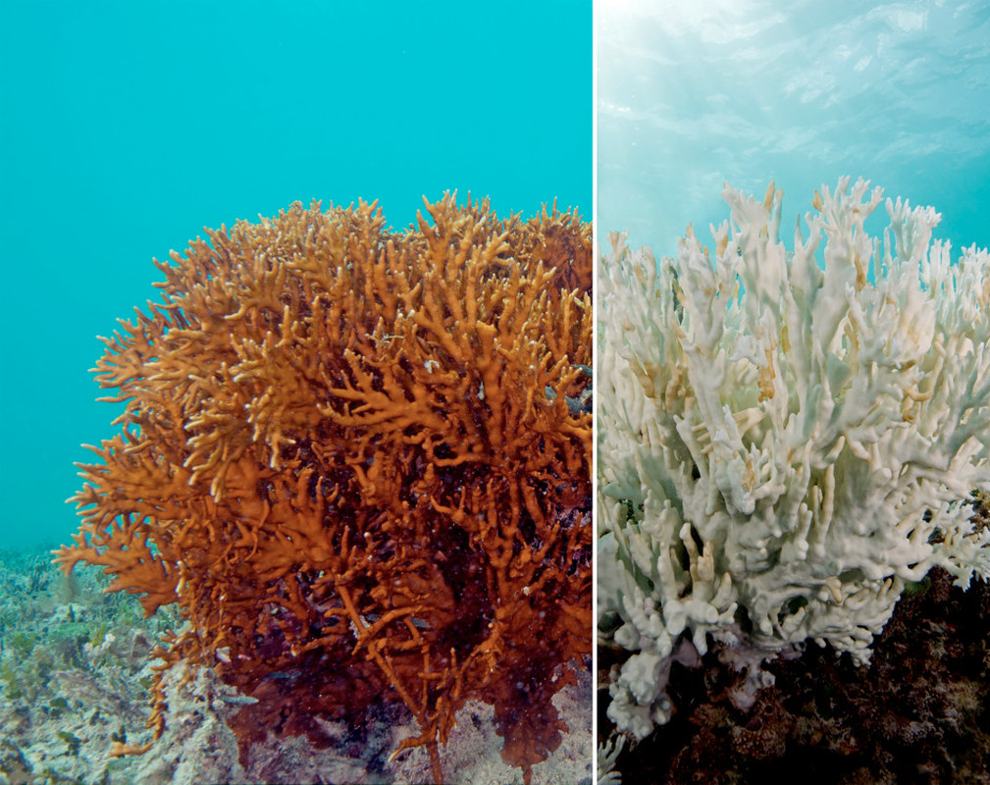
BLEACHING PROCESS
Bleaching is when the jellyfish loses its vibrant colors and turns white. The bleaching process starts when an organism is stressed by changes in its environment. For example, change in temperature, lack or excess amount of light, change in nutrients.

Slide 5
Background information
Main factors that affect bleaching:
Heat
UV radiation
Chemical exposure
Thus, to test the effect of a certain gene presence/absence on bleaching, those variables must stay constant
Light

Slide 6
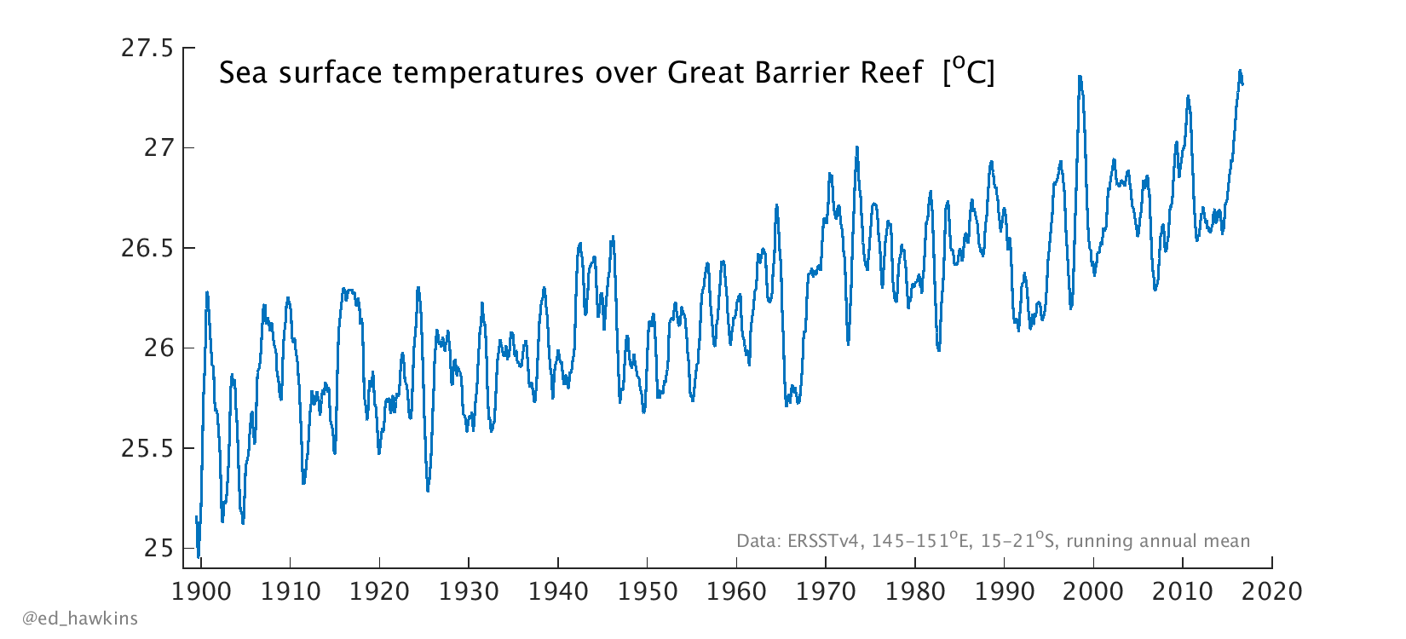
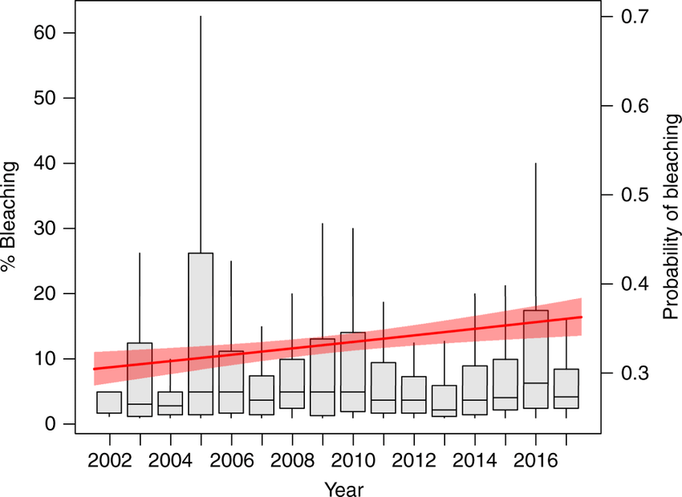
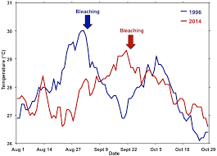
Data

Slide 7

GENES of the interest
5HT1-A: receptor that is involved in neuroregulation.
- Why does bleaching occur, in general?
DopR2: receptor involved in memory erosion (the geological process in which earthen materials are worn away and transported by natural forces such as wind or water)

Slide 8
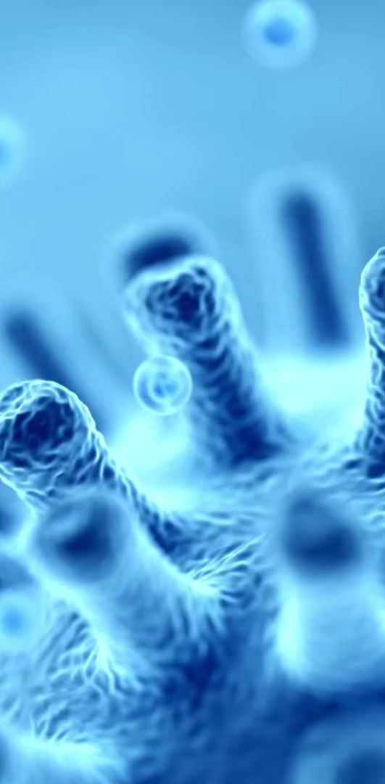
Conditions of the experiment
Dependent variables: Bleaching effect
Independent variables: Gene we are knocking out
Constant factors: Nutrients for the jelly fish, temperature, climate, amount of chemicals, UV radiation
Positive control treatments: the presence of the gene knock out effect on bleaching
Negative control treatments: the absence of the gene knock out effect on bleaching

Slide 9
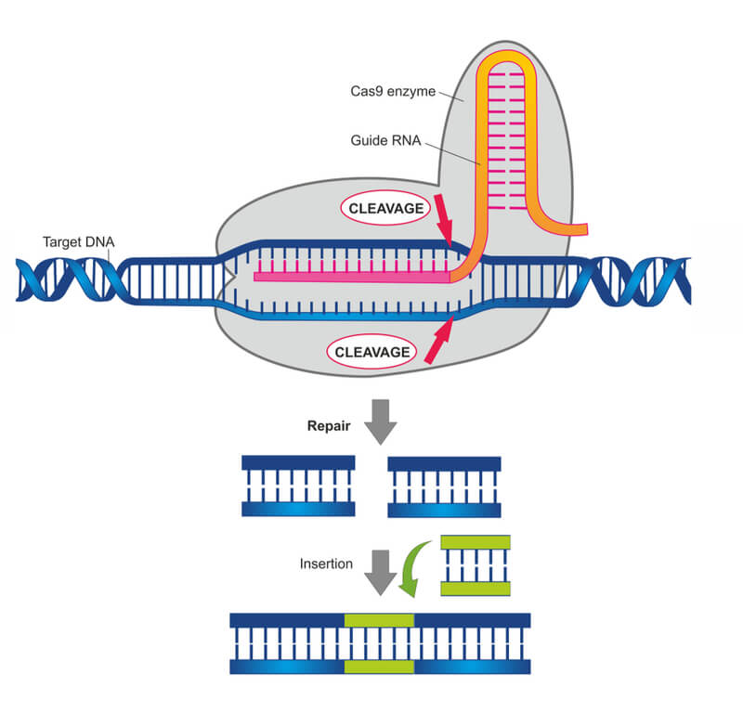
Methods
CRISPR knockout:
The CRISPR-Cas9 system is a common method used in a gene editing technologies. It is a great way of random introducing errors into the target site, which helps to identify the essential genes by first inactivating them and then determining if the cells or organisms carrying these mutations are inviable

Slide 10
details
The sgRNA-mediated CRISPR/Cas9 is usually used to target the open reading frame of a gene in the genome and then, analyze the in-frame (3n) and frameshift (3n + 1 and 3n + 2) mutations in the targeted region of the gene in surviving cells. If the gene is non-essential, the cells would carry both in-frame (3n) and frameshift (3n + 1 and 3n + 2) mutations. However, the cells would carry only in-frame (3n) mutations if the targeted gene is essential, and this selective elimination of frameshift (3n + 1 and 3n + 2) mutations of the gene indicate its essentiality.

Slide 11
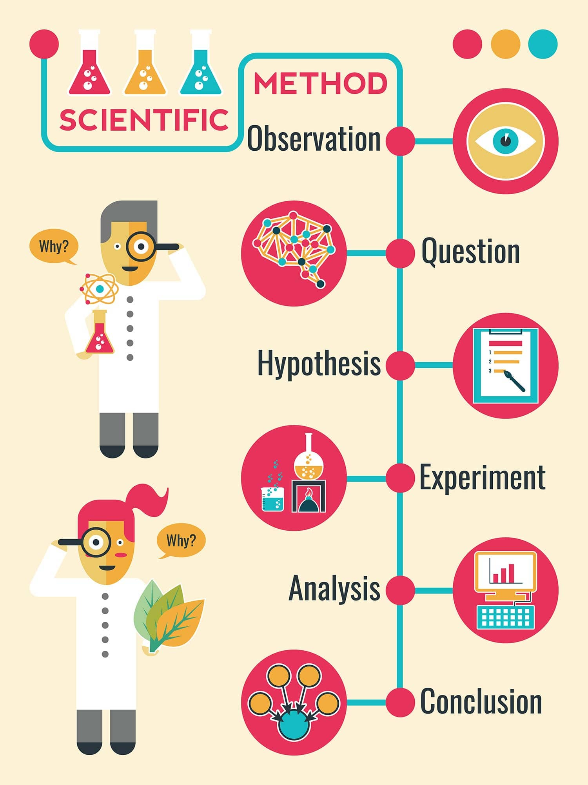
Summary
The main reason that affects bleaching is a climate change. As atmosphere gets warmer, the water temperature increases as well. During this process, symbiotic algae is being ejected from the animal's tissue making it weaker and, as following, starting the process of bleaching.
Thus, if we knock out genes that are necessary for the neural response toward environmental changes, it may prevent an organism from bleaching since the effect of a climate change will not be "recognized" by an organism.
Needs to be added for the reliable conclusion: observation, experiment

Slide 12
Thank you for your time!

